Slide 1
Characteristics of Big Data V’s Of Big Data

Slide 2
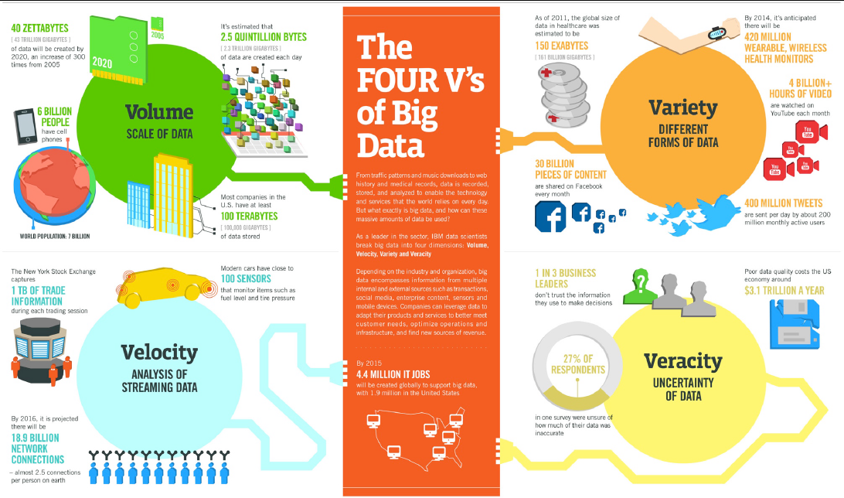

Slide 3
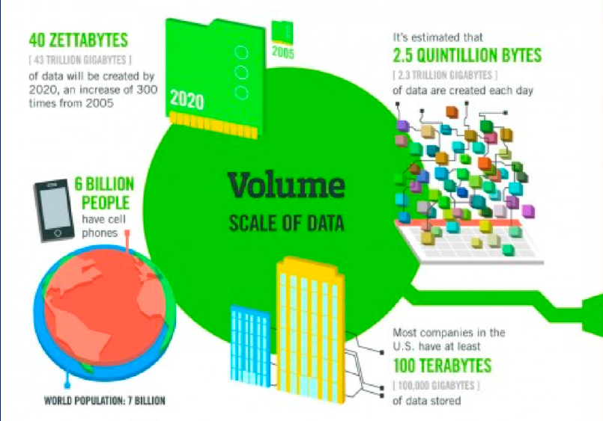

Slide 4
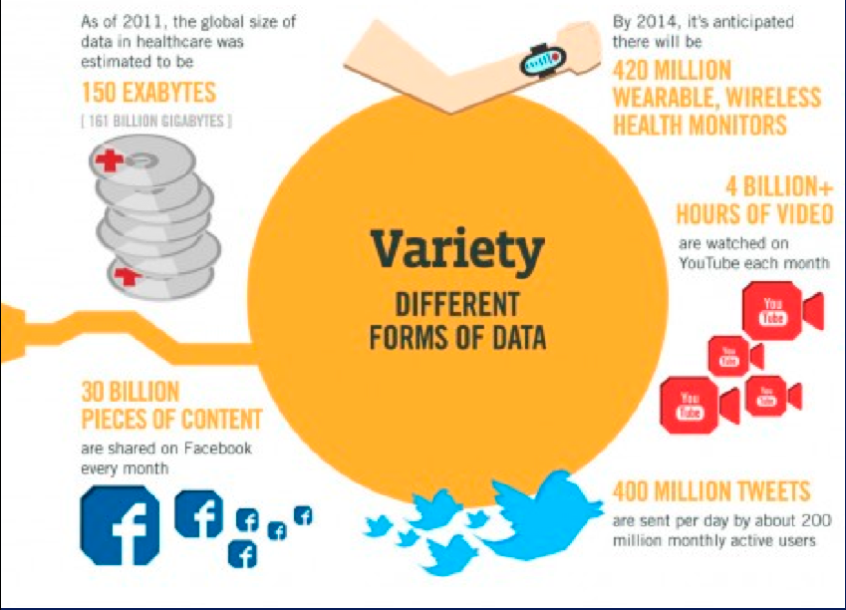

Slide 5
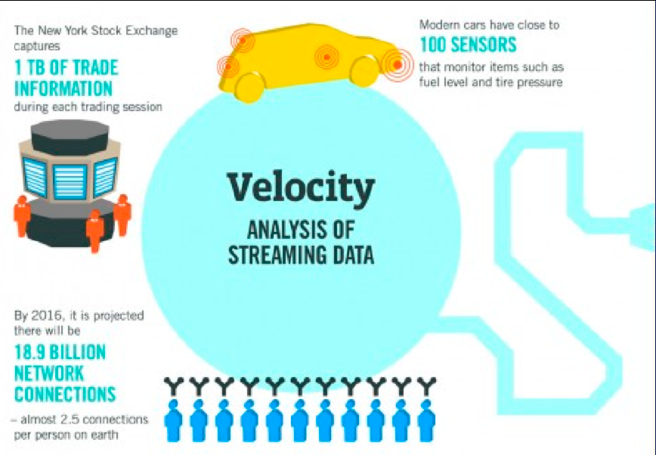

Slide 6
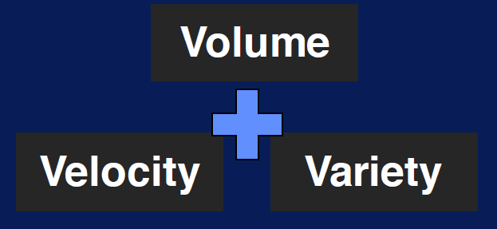
Characteristics of Big Data

Slide 7
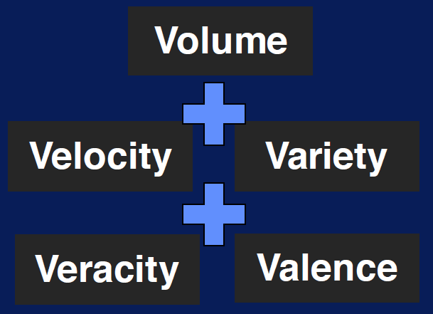
Characteristics of Big Data

Slide 8
Characteristics of Big Data

Slide 9
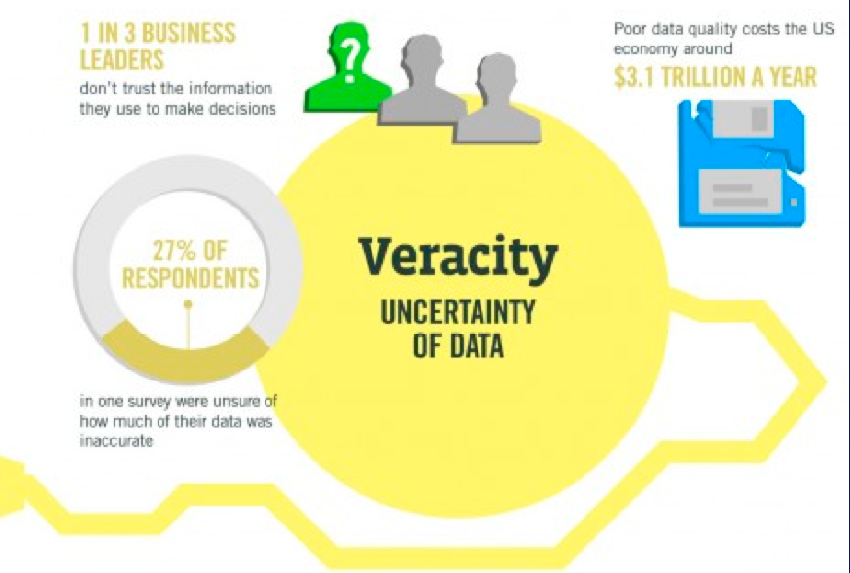

Slide 10
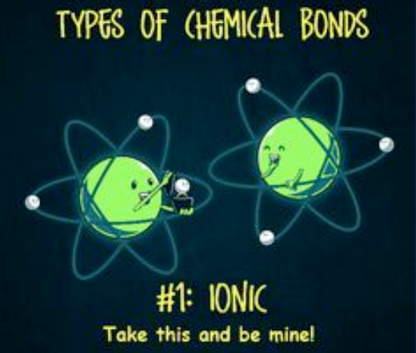

Slide 11
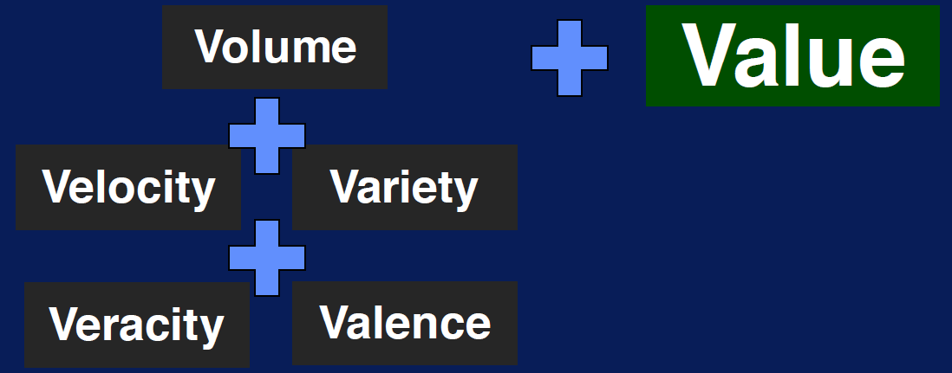

Slide 12
Volume

Slide 13
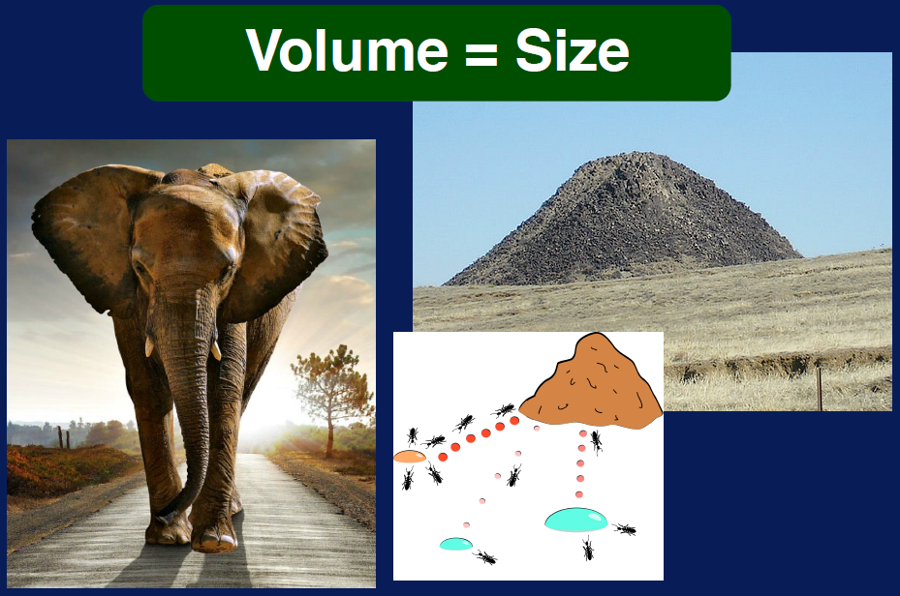

Slide 14
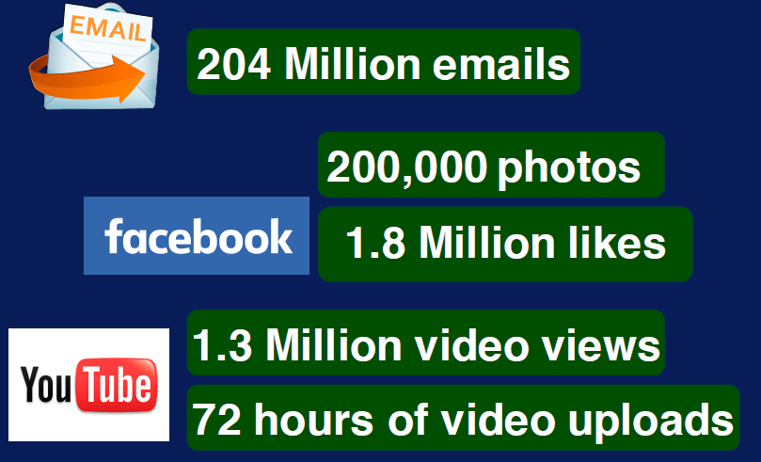
Every Minute…

Slide 15
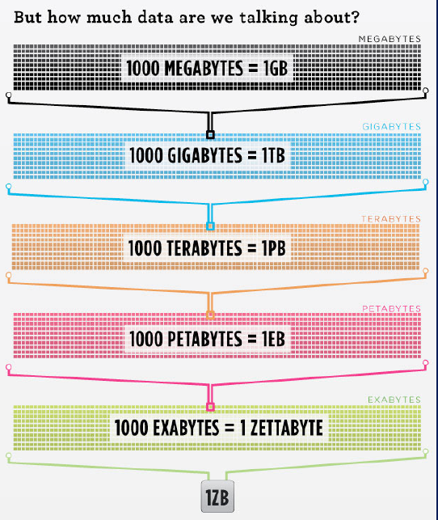

Slide 16
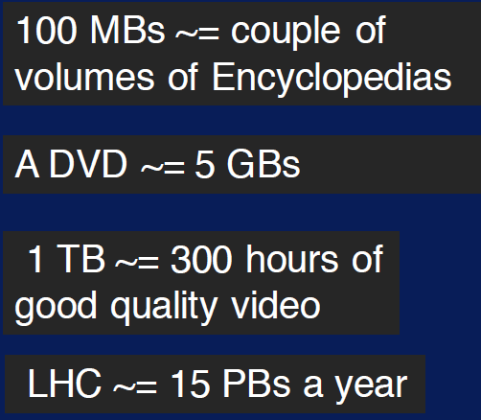

Slide 17
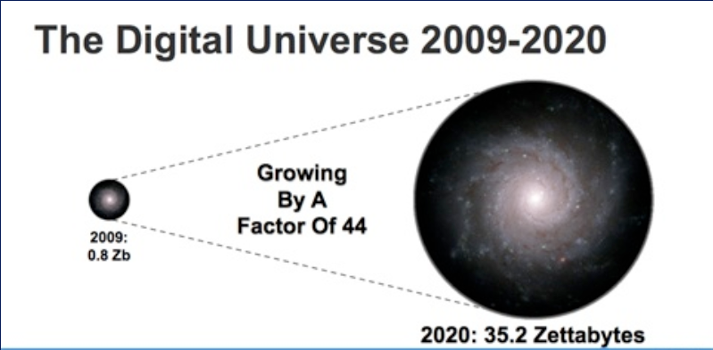

Slide 18
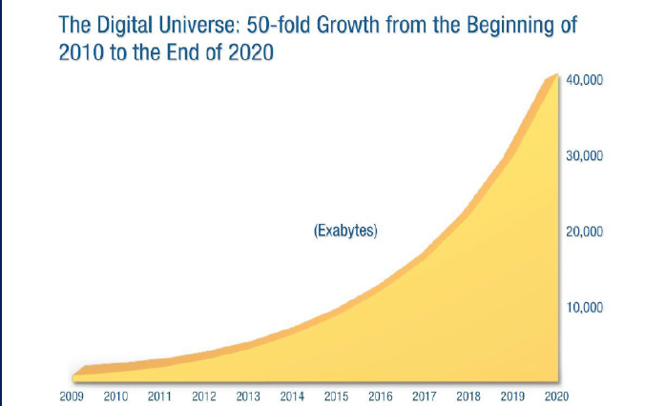
Exponential Growth of data

Slide 19
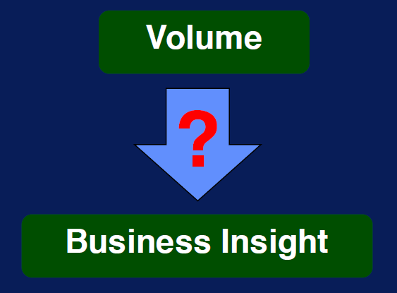

Slide 20
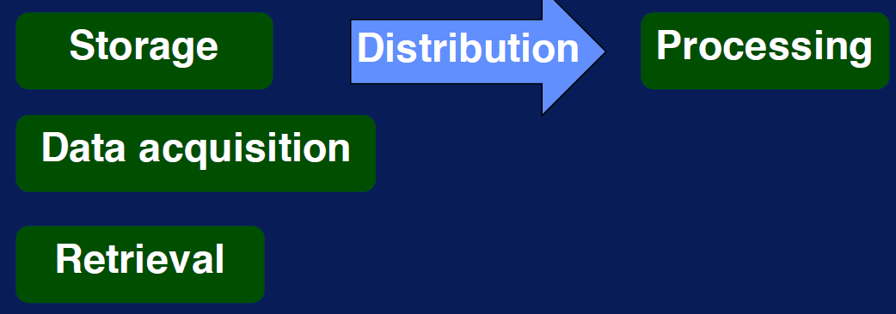
Challenge: storage and more…

Slide 21
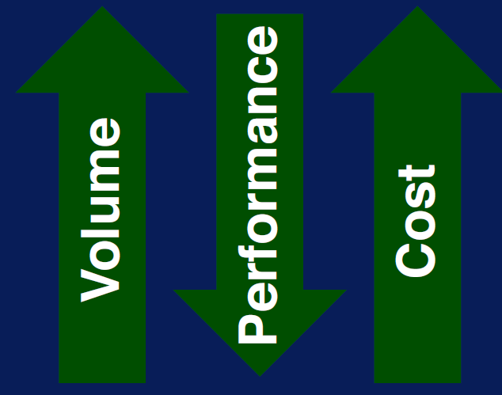
Processing Big Data

Slide 22
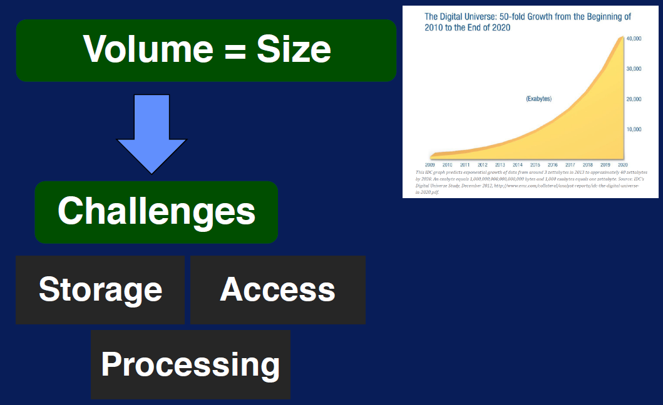

Slide 23
Scalability Variety

Slide 24
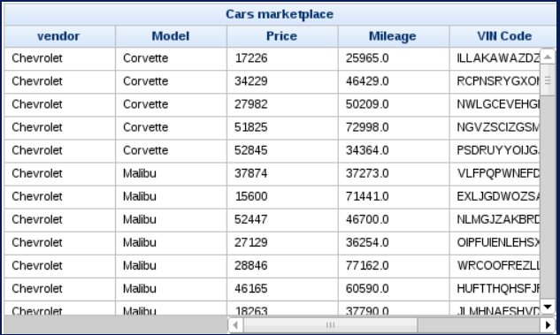
Variety == Complexity Data were confined to tables only

Slide 25
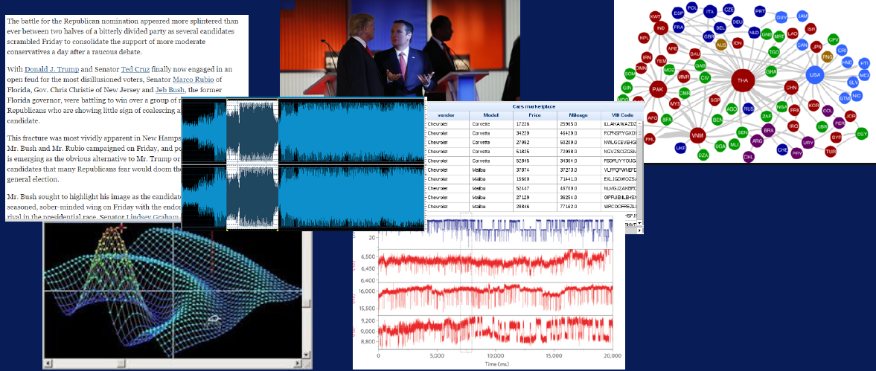
Today… Data are more heterogeneous

Slide 26
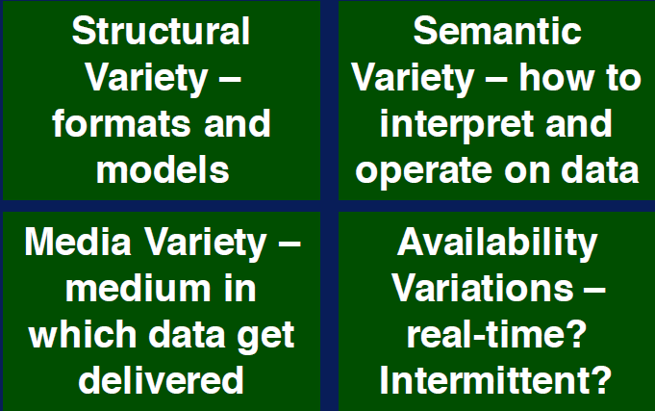
Axis of Data Variety

Slide 27
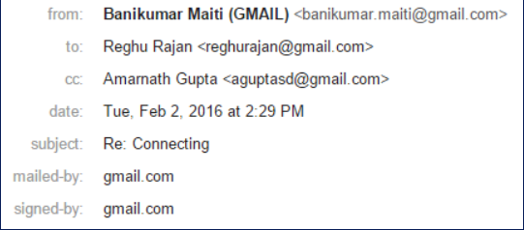
Variety within a type… Think of an email collection Table like part

Slide 28
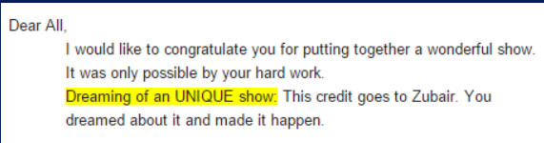
Variety within a type…
Think of an email collection Table like part
Sender, Receiver Date → Strustured
Text → Unstructured

Slide 29
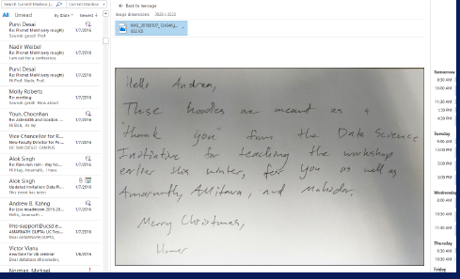
Variety within a type…
Sender, Receiver Date → Strustured
Text → Unstructured
Attachment →MultiMedia

Slide 30
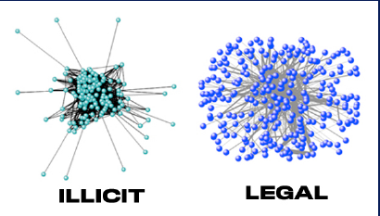
Variety within a type…
Sender, Receiver Date → Strustured
Text → Unstructured
Attachment →MultiMedia
Who-sends-to-whom→Network

Slide 31
Variety within a type…
Sender, Receiver Date → Strustured
Text → Unstructured
Attachment →MultiMedia
Who-sends-to-whom→Network
A Current Email Can reference to past emails??→ Semantics

Slide 32
Variety within a type…
Sender, Receiver Date → Strustured
Text → Unstructured
Attachment →MultiMedia
Who-sends-to-whom→Network
A Current Email Can reference to past emails??→ Semantics
Real time??→ Availability

Slide 33
Variety within a type…
Harder to ingest
Difficult to create common Storage
Difficult compare and match data across variety
Difficult to integrate
Management and policy challenges

Slide 34
Velocity

Slide 35
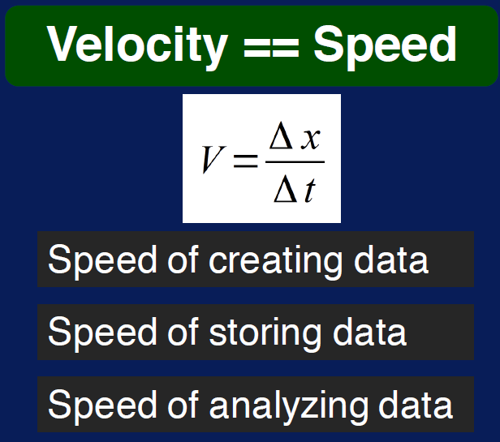

Slide 36


Slide 37
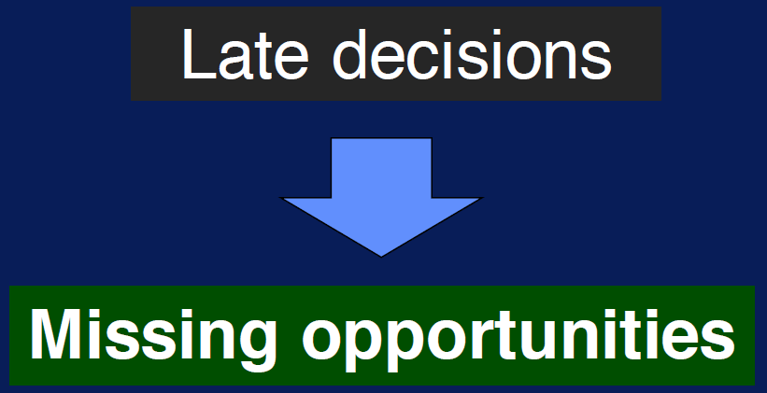

Slide 38


Slide 39
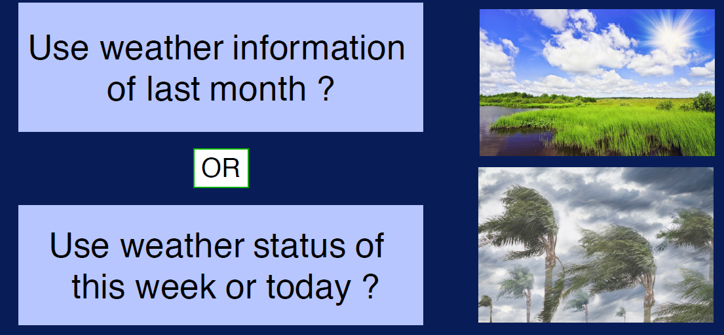
How to decide what to pack??

Slide 40



Slide 41


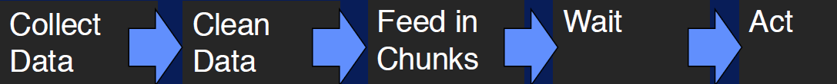

Slide 42


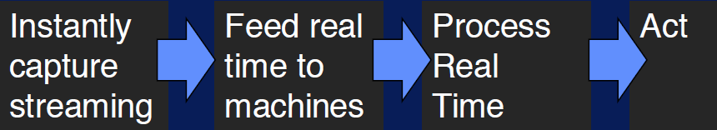

Slide 43
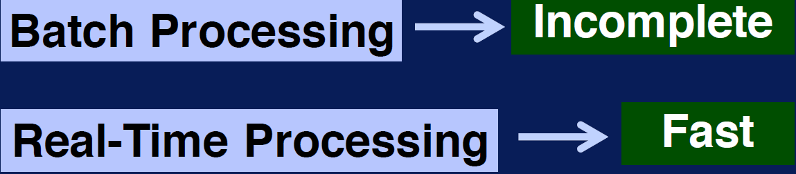

Slide 44
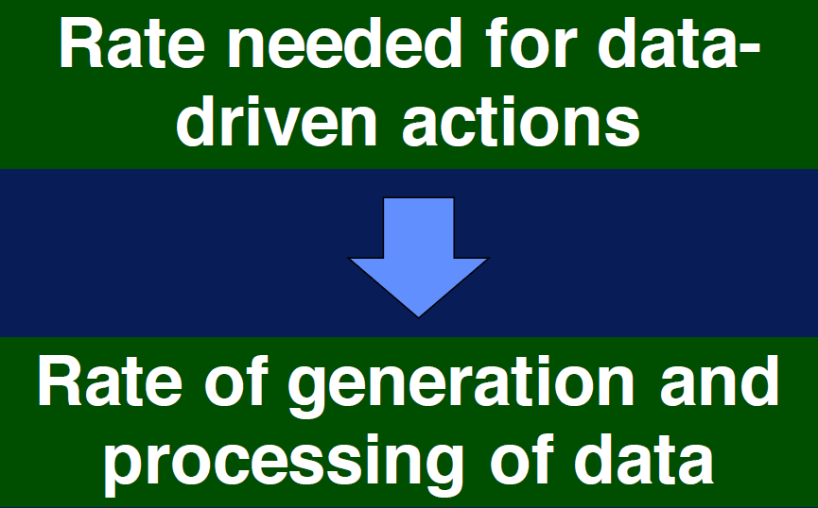

Slide 45
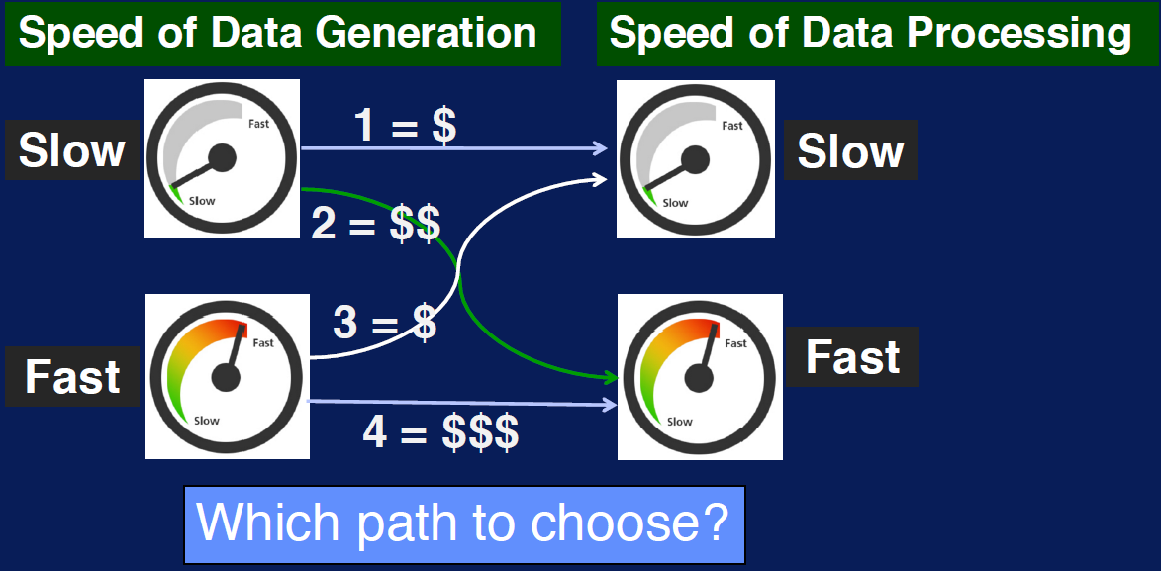

Slide 46
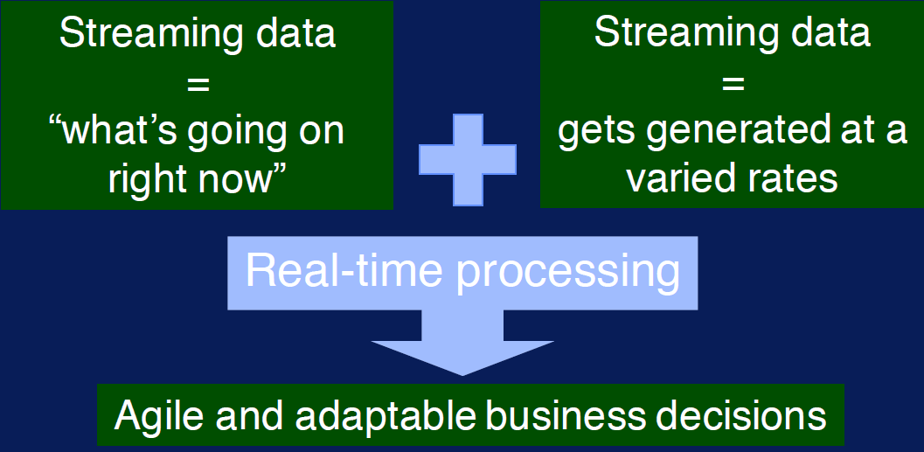

Slide 47
Veracity

Slide 48
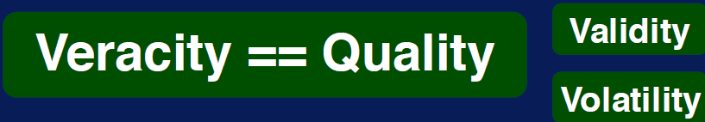
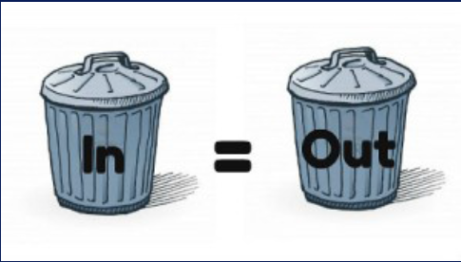

Slide 49

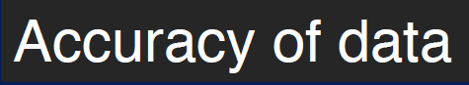


Slide 50
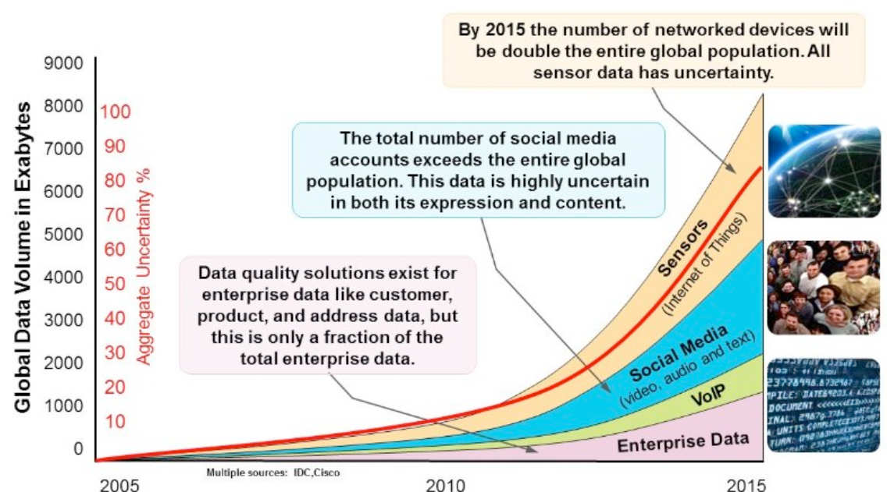


Slide 51
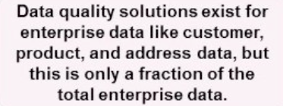
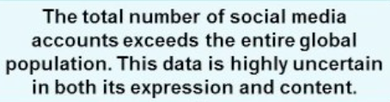
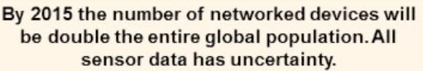

Slide 52

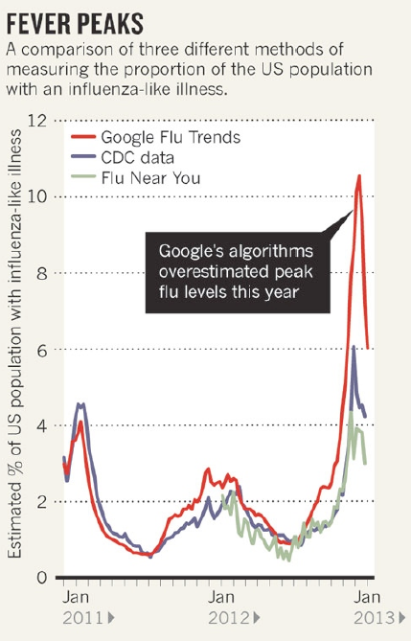


Slide 53
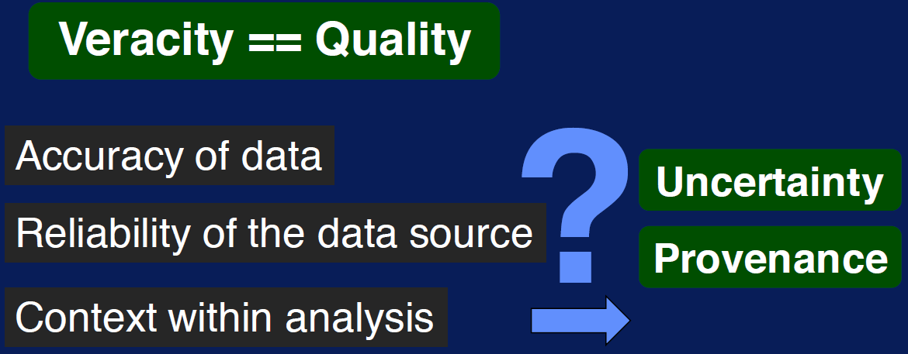

Slide 54
Value

Slide 55
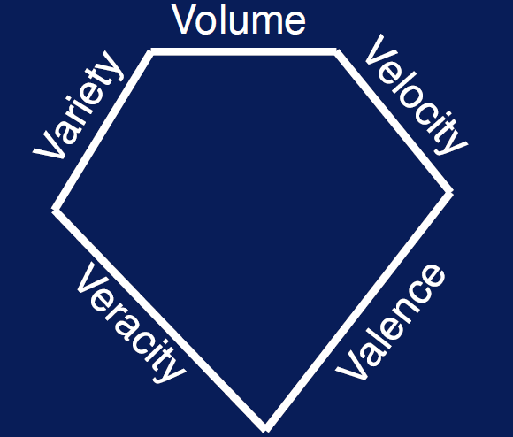

Slide 56
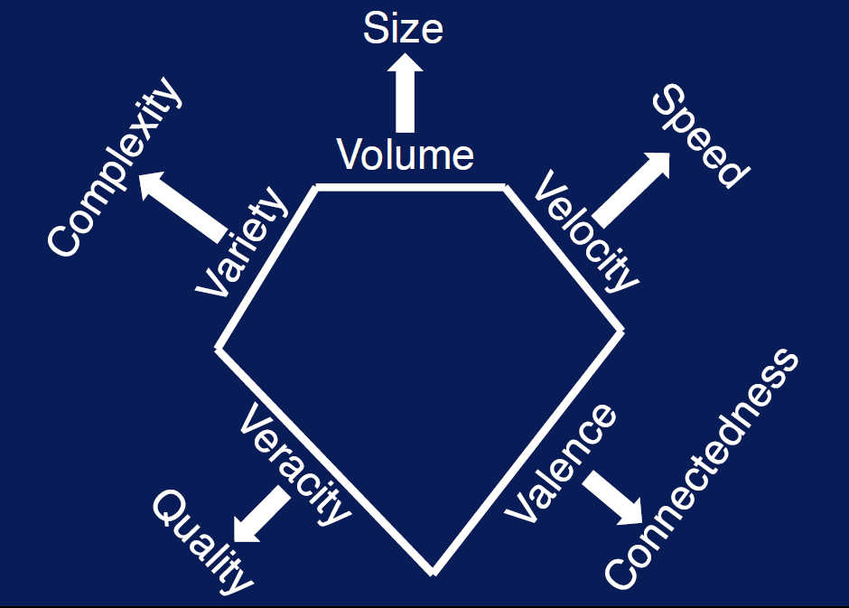

Slide 57
